Slide 1
Comparing multiple representations to calculate theoretical probabilities for combined events
Probability: theoretical probabilities

Slide 2
How our teaching resources are designed for the classroom

Slide 3
I can compare and contrast the usefulness of the different representations when calculating theoretical probabilities for combined events.

Slide 4
Each branch of a probability tree shows a possible outcome from an event or from a stage of a trial, along with the probability of that outcome happening.
A sample space is all the possible outcomes of a trial. A sample space diagram is a systematic way of producing a sample space.
Venn diagrams are a representation used to model statistical/probability questions. Commonly circles are used to represent events.

Slide 5

Comparing multiple representations to calculate theoretical probabilities for combined events
Showing two-stage trials across different diagrams
Statements for events across different diagrams

Slide 6
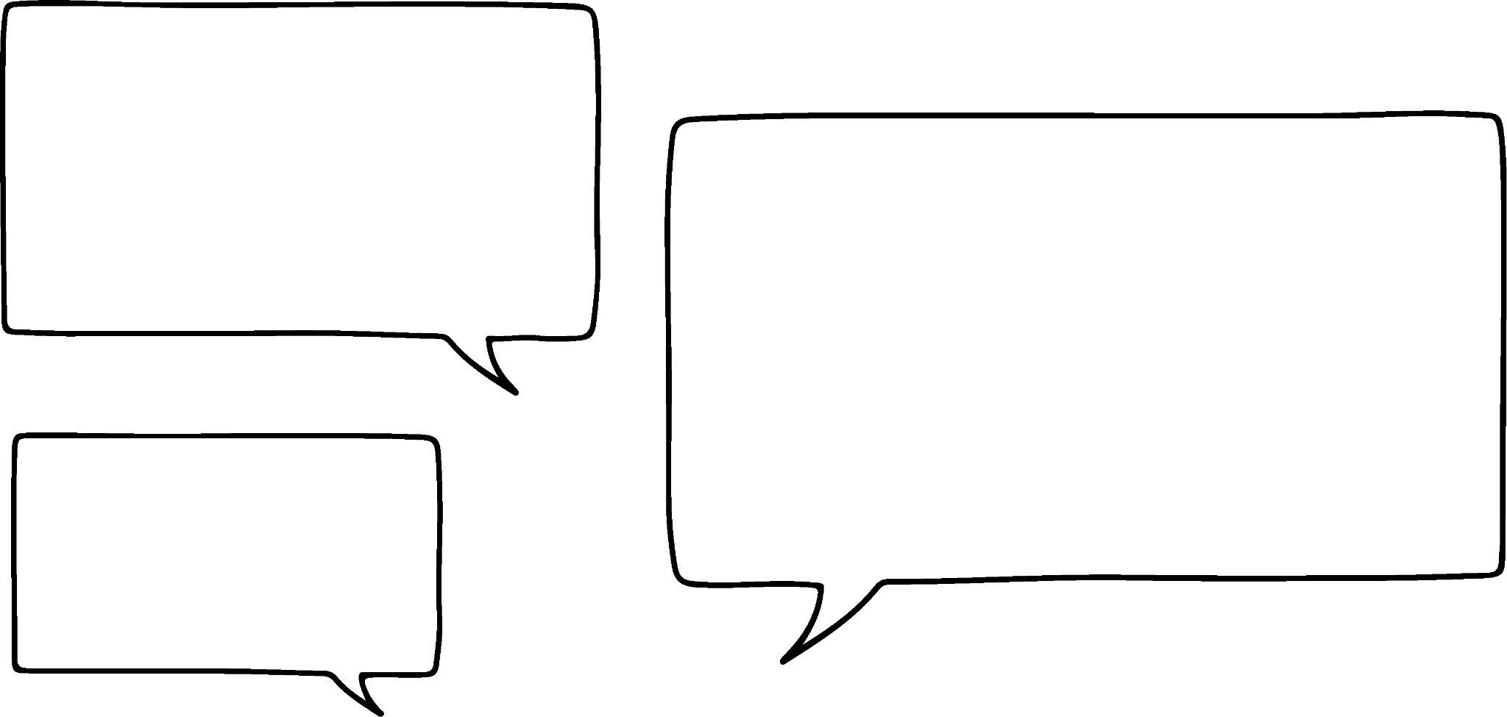

Showing two-stage trials across different diagrams
Trial: spinner 1 and spinner 2 will be spun once each.
I know how to find the probability for each outcome of this trial using an outcome table!
B
A
B
A
A
outcomes of spinner 1
Jun
A
A
B
 | A | A | A | A | A | B | B | B
X
X
Y
 | A | A | A | A | A | B | B | B
X | X A | X A | X A | X A | X A | X B | X B | X B
X | X A | X A | X A | X A | X A | X B | X B | X B
Y | Y A | Y A | Y A | Y A | Y A | Y B | Y B | Y B
spinner 1
X
Y
X
outcomes of spinner 2
sample space for this two -stage trial
spinner 2

Slide 7








Showing two-stage trials across different diagrams
Trial: spinner 1 and spinner 2 will be spun once each.
The same two-stage trial can be shown on a probability tree.
Each layer of branches represents one stage of the trial.
outcomes of spinner 2
outcomes of spinner 1
sample space
B
A
X
AX
B
A
A
A
A
A
B
AY
The probability of each outcome in the sample space is the product of the probabilities of the two branches that lead to that outcome.
spinner 1
Y
X
BX
X
Y
B
X
Y
BY
spinner 2

Slide 8
Showing two-stage trials across different diagrams
Trial: spinner 1 and spinner 2 will be spun once each.
We can also find probabilities from this sample space.
sample space
B
A
X
AX
B
A
P(X and A) =
A
A
A
A
B
Y
AY
spinner 1
X
BX
X
Y
B
X
Y
BY
spinner 2

Slide 9

Showing two-stage trials across different diagrams
Trial: spinner 1 and spinner 2 will be spun once each.
We can also find probabilities from this sample space.
sample space
B
A
X
AX
B
A
P(X or A) =
A
A
A
A
B
+
+
=
Y
AY
spinner 1
X
BX
X
Y
B
X
Y
BY
spinner 2

Slide 10
Showing two-stage trials across different diagrams
But the outcome table is also really good at showing where each probability comes from.
I think I prefer the probability tree, as you can see the probabilities straight away…
X
AX
Jun
A
 | A | A | A | A | A | B | B | B
X | X A | X A | X A | X A | X A | X B | X B | X B
X | X A | X A | X A | X A | X A | X B | X B | X B
Y | Y A | Y A | Y A | Y A | Y A | Y B | Y B | Y B
Y
AY
X
BX
B
Y
BY

Slide 11


Showing two-stage trials across different diagrams
Where on each sample space is the event of “either X or B, but not both” shown?
What’s the probability of this event happening?
+
=
X
AX
A
 | A | A | A | A | A | B | B | B
X | X A | X A | X A | X A | X A | X B | X B | X B
X | X A | X A | X A | X A | X A | X B | X B | X B
Y | Y A | Y A | Y A | Y A | Y A | Y B | Y B | Y B
Y
AY
X
BX
B
Y
BY

Slide 12

Showing two-stage trials across different diagrams
These two diagrams show the same trial: spinning two spinners once each.
The outcomes of each spin are added together.
Using the outcome table, what two probabilities go on the two branches?
5
2
 | 5 | 5 | 5 | 9 | 9 | 9 | 9
2 | 7 | 7 | 7 | 11 | 11 | 11 | 11
4 | 9 | 9 | 9 | 13 | 13 | 13 | 13
4 | 9 | 9 | 9 | 13 | 13 | 13 | 13
9
5
4
9

Slide 13


Showing two-stage trials across different diagrams
Which two fractions must be multiplied together to find the probability of getting a 9?
5
7
×
=
2
 | 5 | 5 | 5 | 9 | 9 | 9 | 9
2 | 7 | 7 | 7 | 11 | 11 | 11 | 11
4 | 9 | 9 | 9 | 13 | 13 | 13 | 13
4 | 9 | 9 | 9 | 13 | 13 | 13 | 13
9
11
5
9
4
9
13

Slide 14
Showing two-stage trials across different diagrams
How many outcomes in the table are 9?
6 out of the 21 outcomes are 9
5
7
2
 | 5 | 5 | 5 | 9 | 9 | 9 | 9
2 | 7 | 7 | 7 | 11 | 11 | 11 | 11
4 | 9 | 9 | 9 | 13 | 13 | 13 | 13
4 | 9 | 9 | 9 | 13 | 13 | 13 | 13
9
11
5
9
4
9
13

Slide 15





Showing two-stage trials across different diagrams
a
How many outcomes are prime?
All the sevens, elevens, and thirteens are prime. There are 15 prime outcomes.
b
What is the probability of the result being a prime number?
5
7
+
+
=
2
 | 5 | 5 | 5 | 9 | 9 | 9 | 9
2 | 7 | 7 | 7 | 11 | 11 | 11 | 11
4 | 9 | 9 | 9 | 13 | 13 | 13 | 13
4 | 9 | 9 | 9 | 13 | 13 | 13 | 13
9
11
5
9
4
9
13

Slide 16
Showing two-stage trials across different diagrams
While I prefer probability trees if there are lots of repeated outcomes in a stage of a trial…
B
A
B
A
X
A
A
A
B
A
spinner 1
Y
Jun
X
X
Y
X
B
spinner 2
Y

Slide 17
Showing two-stage trials across different diagrams
If each stage has a load of unique outcomes, the tree will be much harder to draw than an outcome table!
D
A
C
B
A
X
Y
spinner 1
Z
Jun
X
 | X | Y | Z
A | A X | A Y | A Z
B | B X | B Y | B Z
C | C X | C Y | C Z
D | D X | D Y | D Z
B
Y
Z
Z
Y
X
C
Y
X
Z
spinner 2
D
X
Y
Z

Slide 18

Showing two-stage trials across different diagrams
A 4-sided dice has the integers 1 to 4.
A spinner has outcomes: {3, 3, 3, 4, 4}
Trial: the dice is rolled once and the spinner is spun once.
Which of these statements are suitable reasons for choosing to show this trial as either an outcome table or probability tree?
a
Outcome table, because there are 4 unique outcomes on the dice.
b
Probability tree, because there are lots of repeated outcomes on the spinner.
Both are sensible reasons for choosing one diagram over the other.

Slide 19

Showing two-stage trials across different diagrams
2
7
1) Trial: this spinner is spun twice, with the outcomes of each spin multiplied together.
a) Complete the outcome table and probability tree for this trial.
2
7
2
2
spinner
 | 2 | 2 | 2 | 2 | 7 | 7
2
2
2
2
7
7
b) Circle the probabilities and outcomes for the event “even number”.
c) Find
P(multiple of 7)
2
7

Slide 20
Showing two-stage trials across different diagrams
2) Trial: spinner A and B will be spun once each. The outcomes are added together.
4
 |  | spinner A
 |  | 1 | 1 | 1 | 2 | 2 | 3 | 3 | 3
 | 4 | 5 | 5 | 5 | 6 | 6 | 7 | 7 | 7
 | 5 | 6 | 6 | 6 | 7 | 7 | 8 | 8 | 8
 | 5 | 6 | 6 | 6 | 7 | 7 | 8 | 8 | 8
1
5
spinner B
4
a) Use the outcome table to complete the probability tree.
2
5
b) How many prime outcomes are there?
4
c) Find P(6 or 8) using the probability tree.
3
5

Slide 21





Showing two-stage trials across different diagrams
2
7
1) Trial: this spinner is spun twice, with the outcomes of each spin multiplied together.
a) Complete the outcome table and probability tree for this trial.
2
7
2
2
spinner
 | 2 | 2 | 2 | 2 | 7 | 7
2 | 4 | 4 | 4 | 4 | 14 | 14
2 | 4 | 4 | 4 | 4 | 14 | 14
2 | 4 | 4 | 4 | 4 | 14 | 14
2 | 4 | 4 | 4 | 4 | 14 | 14
7 | 14 | 14 | 14 | 14 | 49 | 49
7 | 14 | 14 | 14 | 14 | 49 | 49
b) Circle the probabilities and outcomes for the event “even number”.
c) Find
P(multiple of 7)
2
4
2
7
14
2
14
7
7
49

Slide 22




Showing two-stage trials across different diagrams
2) Trial: spinner A and B will be spun once each. The outcomes are added together.
4
5
 |  | spinner A
 |  | 1 | 1 | 1 | 2 | 2 | 3 | 3 | 3
 | 4 | 5 | 5 | 5 | 6 | 6 | 7 | 7 | 7
 | 5 | 6 | 6 | 6 | 7 | 7 | 8 | 8 | 8
 | 5 | 6 | 6 | 6 | 7 | 7 | 8 | 8 | 8
1
5
6
spinner B
4
6
a) Use the outcome table to complete the probability tree.
2
5
7
b) How many prime outcomes are there?
10 prime outcomes
4
7
c) Find P(6 or 8) using the probability tree.
3
+
+
=
8
5

Slide 23
Comparing multiple representations to calculate theoretical probabilities for combined events
Showing two-stage trials across different diagrams
Statements for events across different diagrams

Slide 24
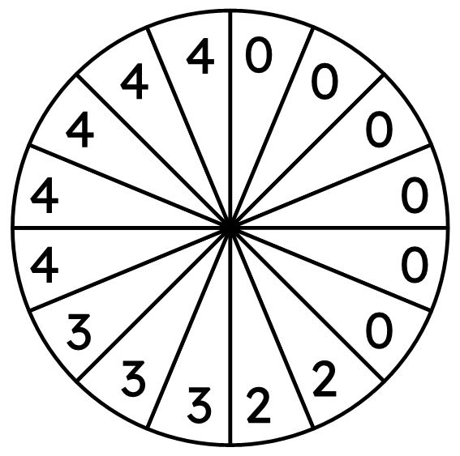
Statements for events across different diagrams
Events: Sam wins, Alex wins
To show these events on a probability tree, we must first categorise the outcomes for each event into two groups (like an outcome tree):
Sam wins
event 1 (Sam wins)
This spinner will be spun once.
If it lands on a:
2
2
4
4
4
4
4
2 or 4 - Sam wins
3 or 4 - Alex wins
0 - no win
Sam doesn’t win
0
0
0
0
0
0
3
3
3

Slide 25
Statements for events across different diagrams
event 2 (Alex wins)
Alex wins
4
4
4
4
4
Sam wins
This spinner will be spun once.
If it lands on a:
2
2
4
4
Alex doesn’t win
4
4
4
2
2
Alex wins
2 or 4 - Sam wins
3 or 4 - Alex wins
0 - no win
3
3
3
Sam doesn’t win
0
0
0
0
0
Alex doesn’t win
0
3
3
3
0
0
0
0
0
0

Slide 26
Statements for events across different diagrams
These same events can be represented on a Venn diagram.
We could show each individual outcome from the spinner categorised into different events…
This spinner will be spun once.
If it lands on a:
ξ
Sam wins
Alex wins
2
4
3
4
3
4
4
2 or 4 - Sam wins
3 or 4 - Alex wins
0 - no win
2
3
4
0
0
0
0
0
0

Slide 27
Statements for events across different diagrams
These same events can be represented on a different type of Venn diagram.
We could show the number of outcomes in each event.
This spinner will be spun once.
If it lands on a:
ξ
Sam wins
Alex wins
5
3
2
2 or 4 - Sam wins
3 or 4 - Alex wins
0 - no win
6

Slide 28




Statements for events across different diagrams
Find P(Sam or Alex wins)
Alex wins
4
4
4
4
4
Sam wins
Alex doesn’t win
2
2
ξ
Sam wins
Alex wins
Alex wins
3
3
3
Sam doesn’t win
Alex doesn’t win
5
3
0
0
0
0
0
0
2
P(Sam or Alex wins) =
+
+
=
6

Slide 29
Statements for events across different diagrams
Find P(Sam or Alex wins)
Alex wins
10 outcomes across either event
4
4
4
4
4
Sam wins
+
+
=
out of a total of 16 outcomes in the sample space
Alex doesn’t win
2
2
ξ
Sam wins
Alex wins
Alex wins
3
3
3
Sam doesn’t win
Alex doesn’t win
5
3
0
0
0
0
0
0
2
P(Sam or Alex wins) =
+
+
=
6

Slide 30
Statements for events across different diagrams
This Venn diagram shows the individual outcomes from a spinner (that has some repeated outcomes).
Events: prime number and multiple of 5
ξ
prime
multiple of 5
(M5)
2
How many individual outcomes are there in this Venn diagram?
2
5
2
10
3
10
7
14 outcomes
4
6
8
8
9
4

Slide 31





Statements for events across different diagrams
This Venn diagram shows the individual outcomes from a spinner (that has some repeated outcomes).
Events: prime number and multiple of 5
Find P(prime or M5) =
M5
ξ
prime
multiple of 5
(M5)
prime
2
not M5
2
5
2
10
3
10
M5
7
not prime
4
6
8
8
9
4
not M5

Slide 32
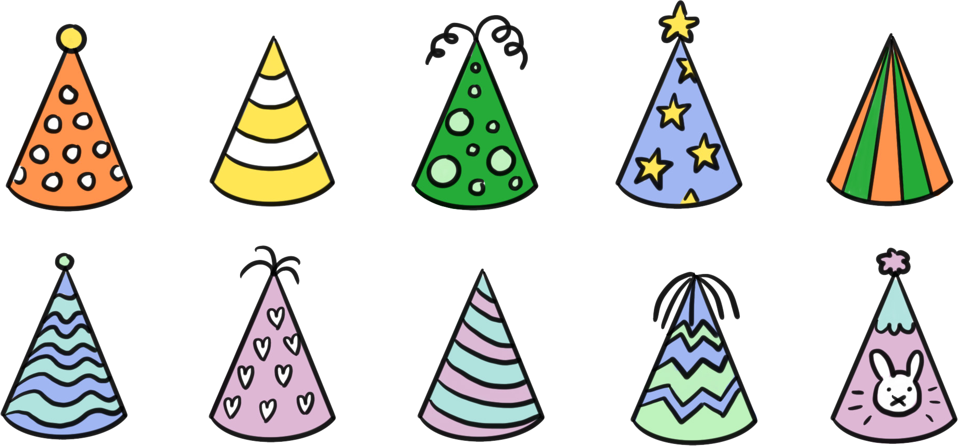










Statements for events across different diagrams
A two-way outcome table shares many similarities with a Venn diagram.
Trial: a toy is chosen at random.
Events: the toy is a bear, the toy has a hat.
The outcome table shows the individual outcomes of the trial.
How can the outcome table be used to complete a Venn diagram that shows the number of outcomes in each event?
 | hat | no hat
bear
not a bear
ξ
bear
hat
5
4
3
1

Slide 33




Statements for events across different diagrams
What part of the outcome table and Venn diagram shows the event of choosing a toy that is either a bear or it wears a hat?
P(bear or hat) =
+
+
=
 | hat | no hat
bear
not a bear
ξ
bear
hat
5
4
3
1
number of outcomes in each event

Slide 34
Statements for events across different diagrams
Trial: randomly select a card with a number on it
Events: the card shows an even number, the card shows a multiple of 3.
Use the correct Venn diagram to identify which part of the outcome table has a missing card. Suggest a possible value of that card.
Odd multiple of 3. For example: 9, 21, 27, 33, 39, 45, 51, 57, 63, 69, …
 | multiple of 3 (M3) | not M3
even
odd
ξ
even
M3
6
36
4
16
78
18
5
3
4
10
22
3
19
2
15
7
99
number of outcomes in each event

Slide 35



Statements for events across different diagrams
Find the probability of:
a
P(M3)
b
P(M3 and not even)
c
P(M3 and even)
 | multiple of 3 (M3) | not M3
even
odd
ξ
even
M3
6
36
4
16
78
18
5
3
4
10
22
3
21
19
2
15
7
99
number of outcomes in each event

Slide 36

Statements for events across different diagrams
Find the probability of:
d
P(even)
e
P(M3 or even)
f
P(neither M3 nor even)
 | multiple of 3 (M3) | not M3
even
odd
ξ
even
M3
6
36
4
16
78
18
5
3
4
10
22
3
21
19
2
15
7
99
number of outcomes in each event

Slide 37
Statements for events across different diagrams
1) Trial: a spinner is spun once.
Events: the spinner lands on a factor of 100 (F100) or a multiple of 5 (M5).
a) Use the outcome table to complete the Venn diagram showing the number of outcomes for each event.
 | (M5) | not M5
F100
not F100
Find these probabilities:
b) P(M5 and F100)
c) P(M5)
d) P(M5 or F100)
5
20
ξ
F100
M5
1
2
25
10
50
4
15
35
3
7
11
75
1005
16
21
33

Slide 38

Statements for events across different diagrams
2) Trial: selecting a random number from a game at a fair.
Events: Izzy wins, Jun wins
a) Use the Venn diagram showing the number of outcomes that result in Izzy or Jun winning to complete the probability tree.
Jun
wins
Find these probabilities:
b) P(Izzy wins)
c) P(only Jun wins)
d) P(either win)
ξ
Izzy wins
Jun wins
Izzy wins
Jun
loses
4
1
7
Jun
wins
20
Izzy loses
Jun
loses

Slide 39
Statements for events across different diagrams
3) Trial: a spinner is spun once.
Events: the spinner lands on a square number or an even number.
a) Complete both the probability tree with probabilities and events, and complete the outcome table with one possible missing outcome.
square
Find:
b) P(square)
c) P(either square or even)
d) P(either square or even, but not both)
 | square | not square
even
odd
even
0
4
16
not
square
2
6
10
36
84
100
22
38
60
144
196
3
5
13
1
9
21
35
45
25
49
57
69
80
not
square

Slide 40



Statements for events across different diagrams
1) Trial: a spinner is spun once.
Events: the spinner lands on a factor of 100 (F100) or a multiple of 5 (M5).
a) Use the outcome table to complete the Venn diagram showing the number of outcomes for each event.
 | (M5) | not M5
F100
not F100
Find these probabilities:
b) P(M5 and F100)
c) P(M5)
d) P(M5 or F100)
5
20
ξ
F100
M5
1
2
25
10
50
4
3
5
4
15
35
3
7
11
16
21
33
6
75
1005

Slide 41





Statements for events across different diagrams
2) Trial: selecting a random number from a game at a fair.
Events: Izzy wins, Jun wins
a) Use the Venn diagram showing the number of outcomes that result in Izzy or Jun winning to complete the probability tree.
Jun
wins
Find these probabilities:
b) P(Izzy wins)
c) P(only Jun wins)
d) P(either win)
ξ
Izzy wins
Jun wins
Izzy wins
Jun
loses
4
1
7
Jun
wins
20
Izzy loses
Jun
loses

Slide 42
Statements for events across different diagrams
3) Trial: a spinner is spun once.
Events: the spinner lands on a square number or an even number.
a) Complete both the probability tree with probabilities and events, and complete the outcome table with one possible missing outcome.
square
 | square | not square
even
odd
even
The missing outcome was an odd number that wasn’t square.
For example:
7, 11, 15, 17, 19, 23, …
0
4
16
not
square
2
6
10
36
84
100
22
38
60
144
196
square
3
5
13
1
9
odd
21
35
45
25
49
57
69
80
not
square

Slide 43
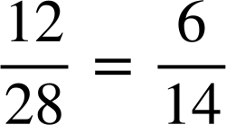
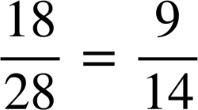
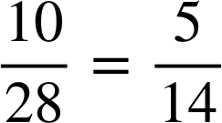
Statements for events across different diagrams
3) Trial: a spinner is spun once.
Events: the spinner lands on a square number or an even number.
a) Complete both the probability tree with probabilities and events, and complete the outcome table with one possible missing outcome.
square
Find:
b) P(square)
c) P(either square or even)
d) P(either square or even, but not both)
 | square | not square
even
odd
even
0
4
16
not
square
2
6
10
36
84
100
22
38
60
144
196
square
3
5
13
1
9
odd
21
35
45
25
49
57
69
80
17
not
square

Slide 44
Comparing multiple representations to calculate theoretical probabilities for combined events
The outcomes of a two-stage trial can be shown on an outcome table, with probabilities calculated from its sample space.
The outcomes and probabilities of a two-stage trial can be shown on a probability tree with two layers of branches.
The outcomes and probabilities of two events (including and/or statements) can be shown on an outcome table, a probability tree, and different types of Venn diagram.

Slide 45

© Oak National Academy 2024.
Produced in partnership with Mathematics in Education and Industry.
Licensed on the Open Government Licence v3.0, except where otherwise stated. See Oak terms and conditions.

